Slide 1


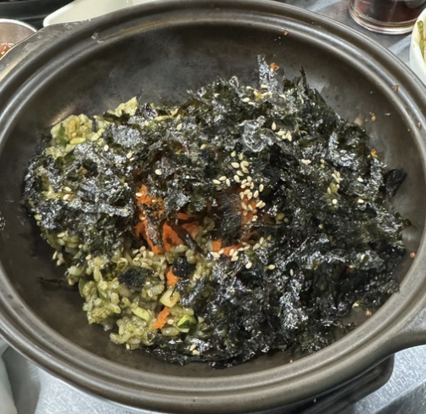
Advantage
Actor-Critic
CIDA Lab.
Presentation: Baekryun Seong
2024.07.10

Slide 2
The Actor
The Critic
A2C Algorithm
Network Architecture
Neural Actor Critic
Table of Contents

Slide 3
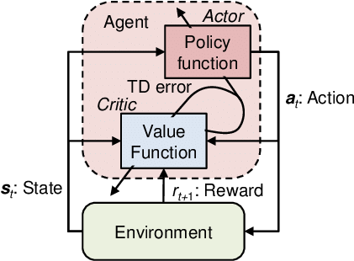
Ch6. Advantage Actor-Critic (A2C)
In A2C, we will use the policy gradient and a learned value function.
In REINFORCE, A policy is reinforced by reward, directly.
But in Actor-Critic, a policy is reinforced with a learned reinforcing signal.

Slide 4
Ch 6.1
The Actor

Slide 5

Ch 6.1 The Actor
In REINFORCE, we used the policy gradient of:
$$∇_{θ}J\left(π_{θ}\right)=𝔼_{t}\left[R_{t}\left(τ\right)∇_{θ}\log{π_{θ}\left(a_{t}|s_{t}\right)}\right].$$
Now in actor-critic, we will use:
$$∇_{θ}J\left(π_{θ}\right)=𝔼_{t}\left[A_{t}^{π}∇_{θ}\log{π_{θ}\left(a_{t}|s_{t}\right)}\right]$$
where $A_{t}^{π}$ is an advantage function.

Slide 6
Ch 6.2
The Critic

Slide 7
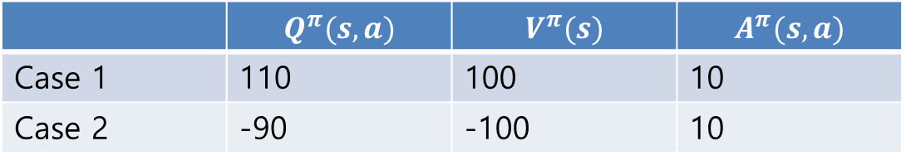
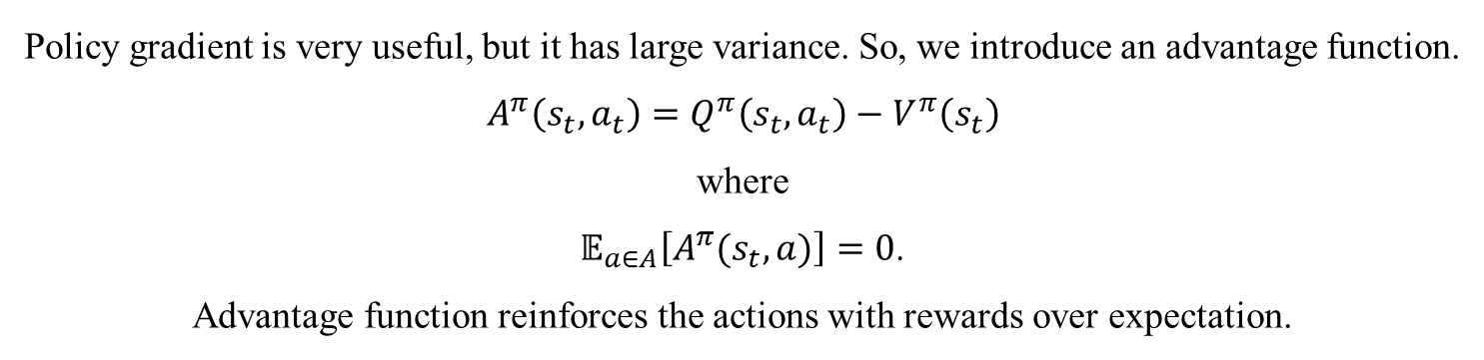
Ch 6.2.1 Advantage Function
Policy gradient is very useful, but it has large variance. So, we introduce an advantage function.
$$A^{π}\left(s_{t},a_{t}\right)=Q^{π}\left(s_{t},a_{t}\right)−V^{π}\left(s_{t}\right)$$
where
$𝔼_{a∈A}\left[A^{π}(s_{t},a)\right]=0$.
Advantage function reinforces the actions with rewards over expectation.
 | $$Q^{π}(s,a)$$ | $$V^{π}(s)$$ | $$A^{π}(s,a)$$
Case 1 | 110 | 100 | 10
Case 2 | -90 | -100 | 10

Slide 8
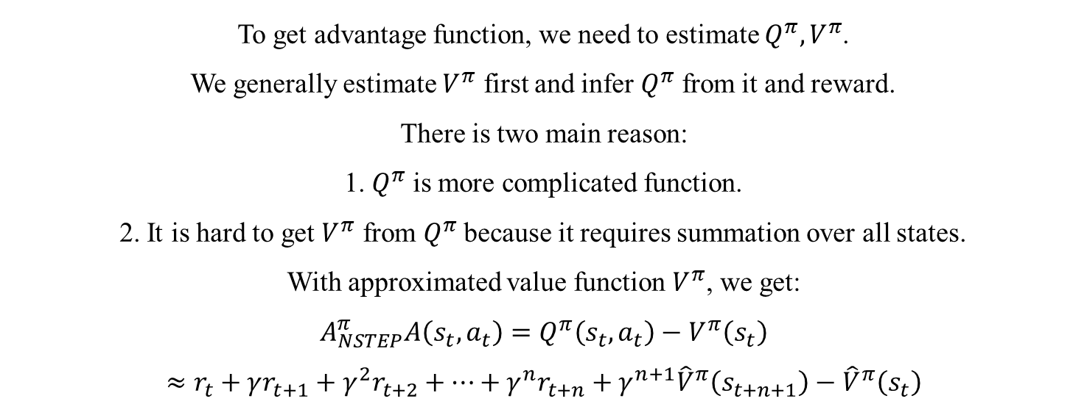
Ch 6.2.1.1 N-step Return
To get advantage function, we need to estimate $Q^{π},V^{π}$.
We generally estimate $V^{π}$ first and infer $Q^{π}$ from it and reward.
There is two main reason:
1. $Q^{π}$ is more complicated function.
2. It is hard to get $V^{π}$ from $Q^{π}$ because it requires summation over all states.
With approximated value function $V^{π}$, we get:
$$A_{NSTEP}^{π}A\left(s_{t},a_{t}\right)=Q^{π}\left(s_{t},a_{t}\right)−V^{π}\left(s_{t}\right)$$
$$≈r_{t}+γr_{t+1}+γ^{2}r_{t+2}+⋯+γ^{n}r_{t+n}+γ^{n+1}{\hat{V}}^{π}\left(s_{t+n+1}\right)−{\hat{V}}^{π}\left(s_{t}\right)$$

Slide 9
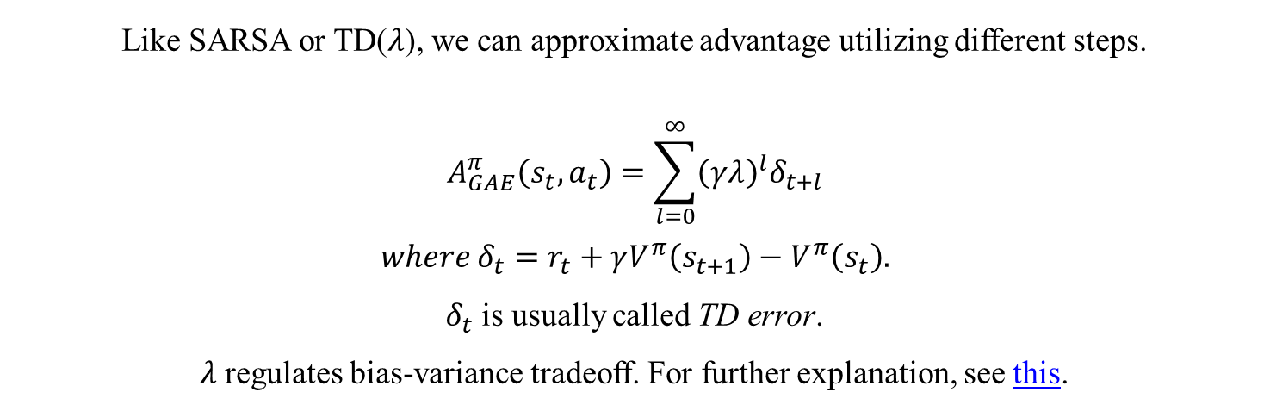
Ch 6.2.1.2 Generalized Advantage Estimation
Like SARSA or TD($λ$), we can approximate advantage utilizing different steps.
$$A_{GAE}^{π}\left(s_{t},a_{t}\right)=\sum_{l=0}^{∞}{{\left(γλ\right)}^{l}δ_{t+l}}$$
$$where δ_{t}=r_{t}+γV^{π}\left(s_{t+1}\right)−V^{π}\left(s_{t}\right).$$
$δ_{t}$ is usually called TD error.
$λ$ regulates bias-variance tradeoff. For further explanation, see this.

Slide 10
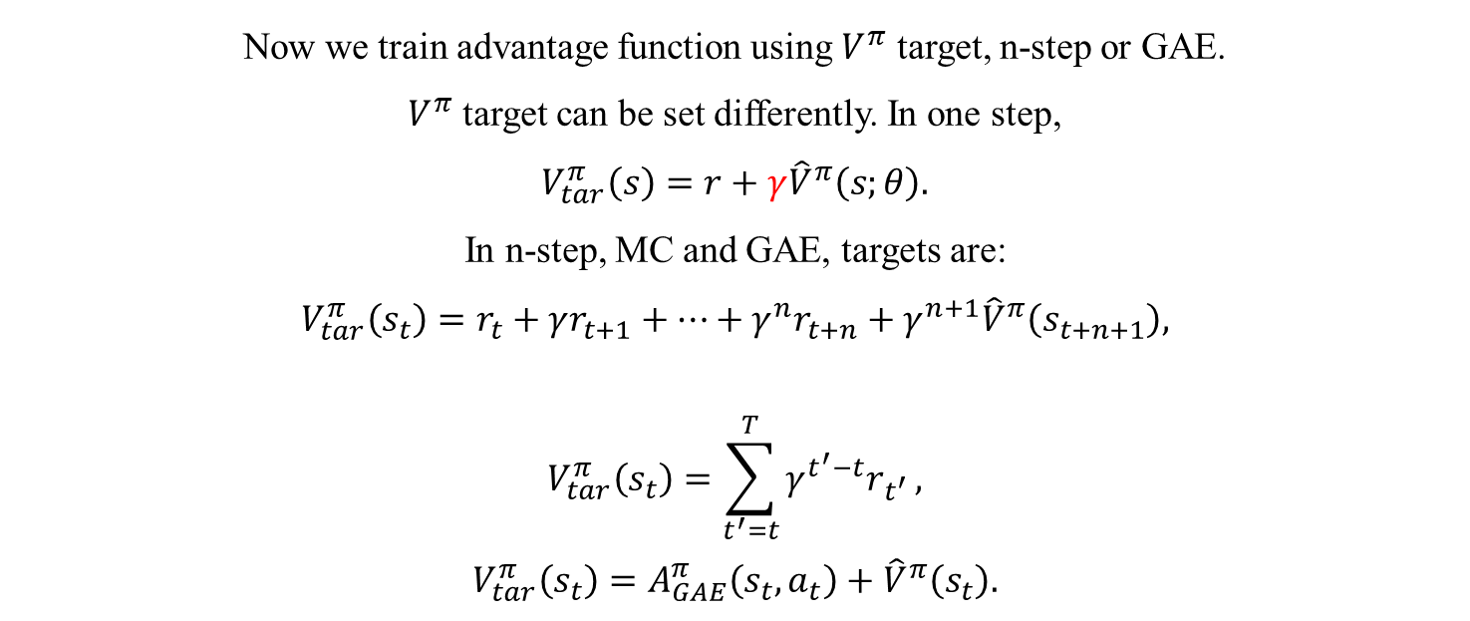
Ch 6.2.2 Training Advantage Function
Now we train advantage function using $V^{π}$ target, n-step or GAE.
$V^{π}$ target can be set differently. In one step,
$$V_{tar}^{π}\left(s\right)=r+γ{\hat{V}}^{π}\left(s;θ\right).$$
In n-step, MC and GAE, targets are:
$$V_{tar}^{π}\left(s_{t}\right)=r_{t}+γr_{t+1}+⋯+γ^{n}r_{t+n}+γ^{n+1}{\hat{V}}^{π}\left(s_{t+n+1}\right),$$
$$V_{tar}^{π}\left(s_{t}\right)=\sum_{t^{′}=t}^{T}{γ^{t^{′}−t}r_{t^{′}}},$$
$$V_{tar}^{π}\left(s_{t}\right)=A_{GAE}^{π}\left(s_{t},a_{t}\right)+{\hat{V}}^{π}\left(s_{t}\right).$$

Slide 11
Ch 6.3
A2C Algorithm

Slide 12
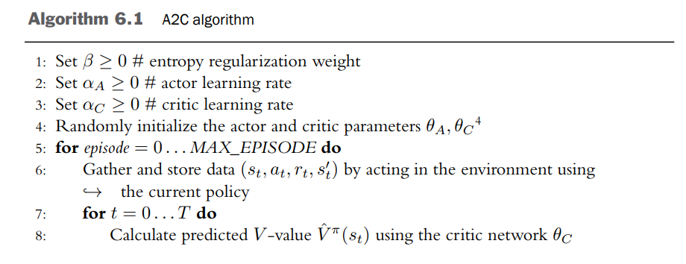
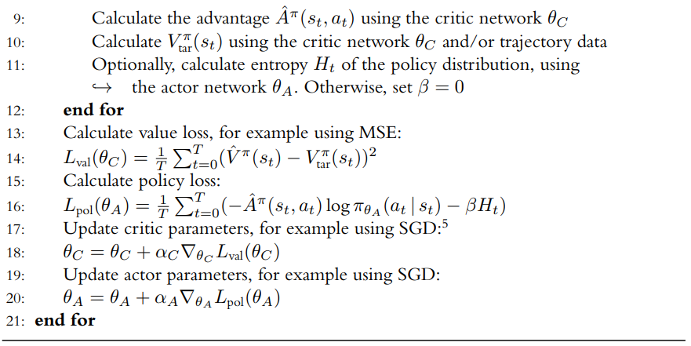
Ch 6.3 A2C Algorithm

Slide 13
Ch 6.5
Network Architecture

Slide 14
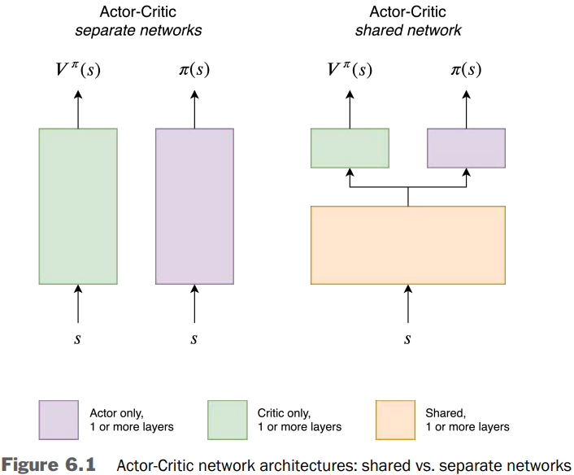
Ch 6.5 Network Architecture
In A2C, we have to train two different networks: actor and critic.
But we can assume that two networks can share some information.
Sharing parameters makes the actor network to utilize state representation of critic net.
But it makes training very unstable, and scale problems may appear.

Slide 15
Appendix
Actor-Critic in Neuroscience

Slide 16
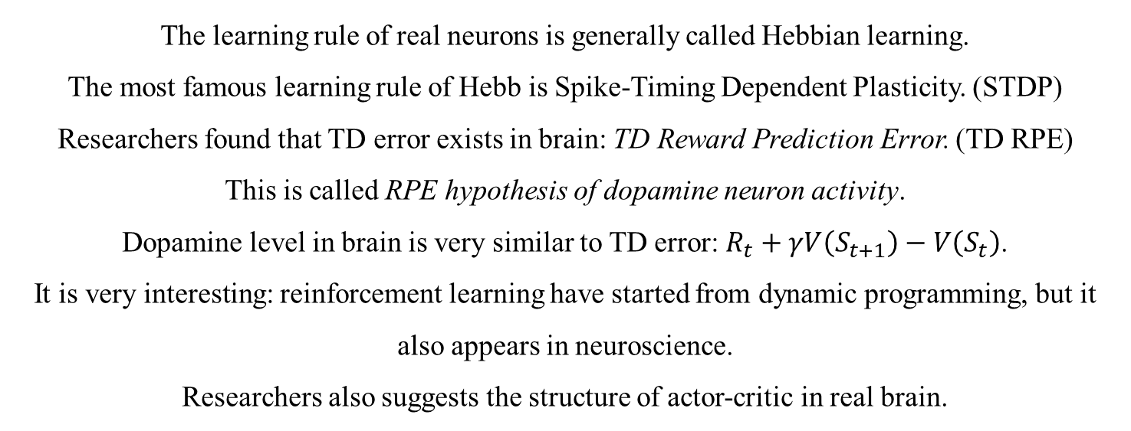
Neural Actor-Critic
The learning rule of real neurons is generally called Hebbian learning.
The most famous learning rule of Hebb is Spike-Timing Dependent Plasticity. (STDP)
Researchers found that TD error exists in brain: TD Reward Prediction Error. (TD RPE)
This is called RPE hypothesis of dopamine neuron activity.
Dopamine level in brain is very similar to TD error: $R_{t}+γV\left(S_{t+1}\right)−V\left(S_{t}\right)$.
It is very interesting: reinforcement learning have started from dynamic programming, but it also appears in neuroscience.
Researchers also suggests the structure of actor-critic in real brain.

Slide 17
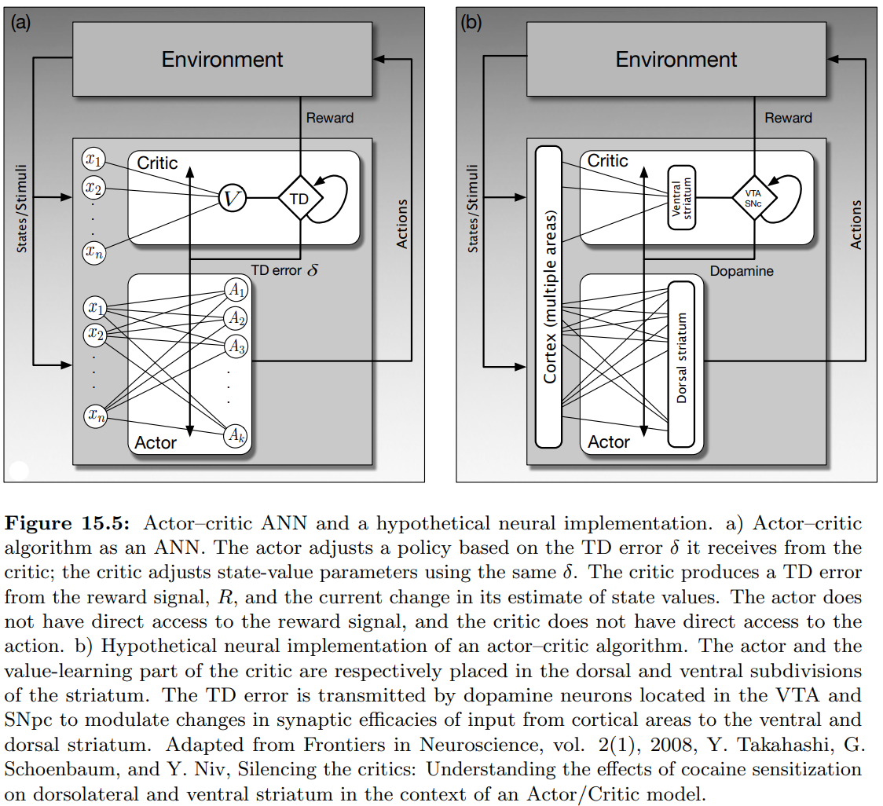
Neural Actor-Critic

